Slide 1


SUBJECT- PROJECT BASED LEARNING
Department:- Computer Engineering
PBL presentation
on
“Plant Identification Care Recommendation”
Prepared By:
Guided by
Prof. Neha Bhagwat
PCET’S & NMVPM’S
NUTAN MAHARASHTRA INSTT. OF ENGG. & TECH. Pune
Mehul Ligade.
Pranav Khandagale.
Akansha Karande.
Pratik Gidde.
Academic Year 2023-24

Slide 2
SUBJECT- PROJECT BASED LEARNING
Department:- Computer Engineering
Contents
Introduction
Abstract
Objectives
Architecture
Methods/Different Methodologies
Scope of Work
Conclusion
References
Academic Year 2022-23

Slide 3
Welcome
Plant Identification And care recommendation

Slide 4

Slide 3
Best Trained & Accurate Model
Everything in Root Directory and Locally Deployed
Latest Programming Libraries
Quick Care Recommadations and Identification
Updated Personalised Dataset
Combining Various Ideas To create A unique Idea or solution.
Use of Open AI and Google
Setting the User friendly envionment

Slide 5
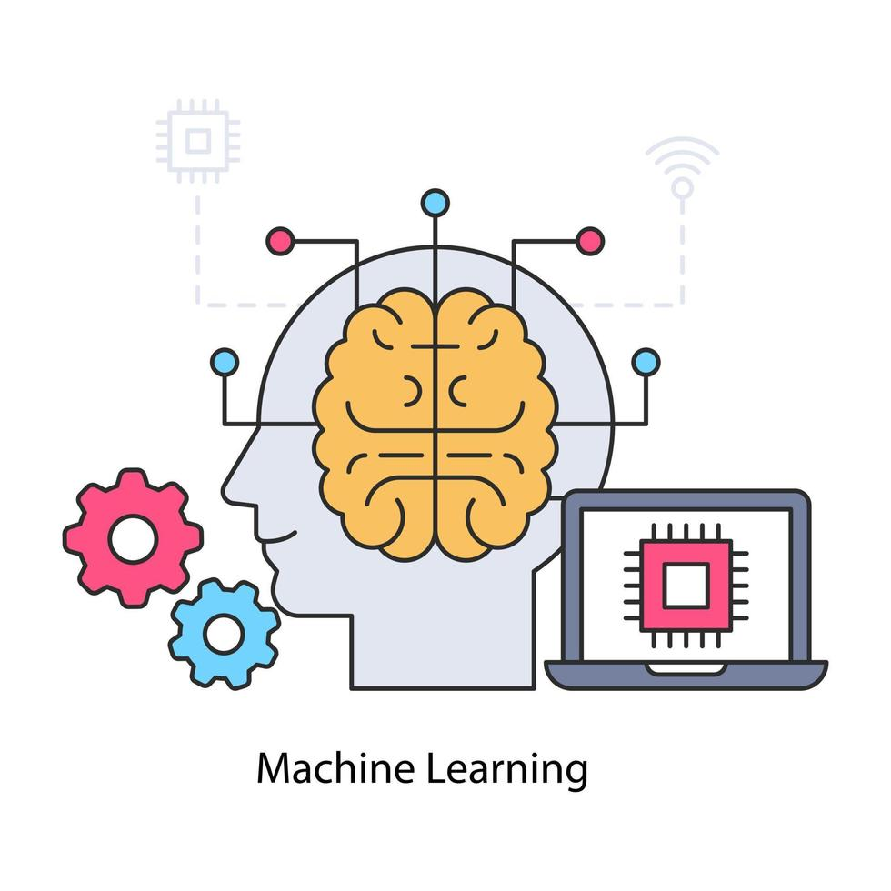
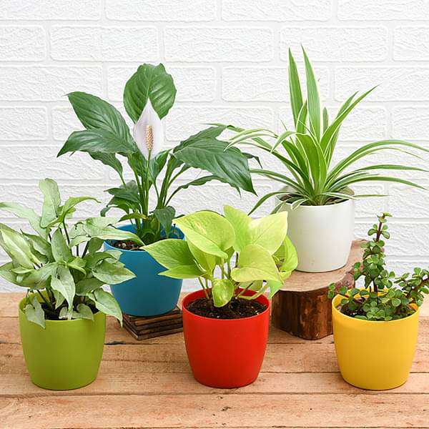
Introduction
In this presentation, we will discuss the exciting advancements in using technology to automate plant identification and care recommendations. Our system combines computer vision and machine learning to quickly identify plants and provide personalized care instructions. By harnessing the power of these technologies, we aim to simplify plant care for enthusiasts of all levels. Join us as we explore the benefits and possibilities of this innovative approach to plant care.

Slide 6

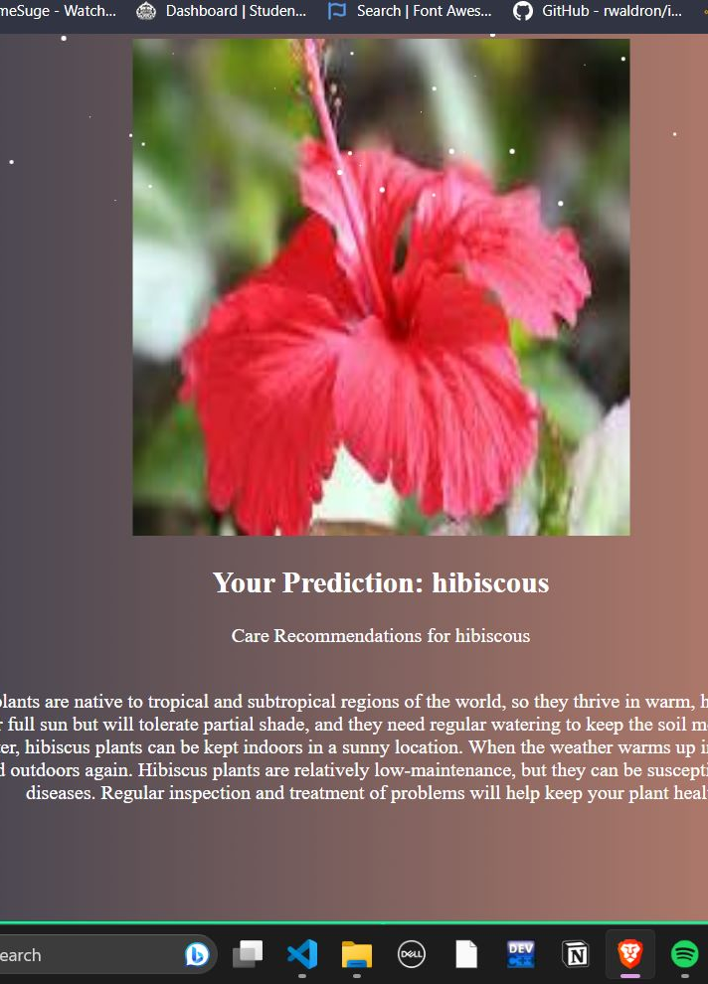
Abstract
The system analyzes pictures of plants using computer algorithms and learns to recognize different plant species based on features like leaf shape, color, and texture. It also includes a database of care instructions for each plant species, including information on watering, sunlight, and temperature requirements. By combining plant identification with the care database, the system gives users specific advice on how to take care of their plants. The system was tested with a variety of plant images and achieved accurate identification and reliable care recommendations. Plant experts and enthusiasts found the system easy to use and helpful. This research shows how computer vision and machine learning can improve plant care and make it more accessible to everyone. In the future, the system could be integrated into mobile apps or smart devices for convenient plant identification and care guidance. Overall, this work demonstrates the value of using technology to automate plant identification and enhance plant care practices.

Slide 7




1.By observing
Death of plants in Garden.
2.Failing to identify Plant.
3.Less Knowledge Towards
Plant classification.
Origin OF
Problem
4.Personalized care instructions for specific plants based on their unique needs
5. Traditional methods relied on books or consulting experts, which were time-consuming and often inaccurate.

Slide 8
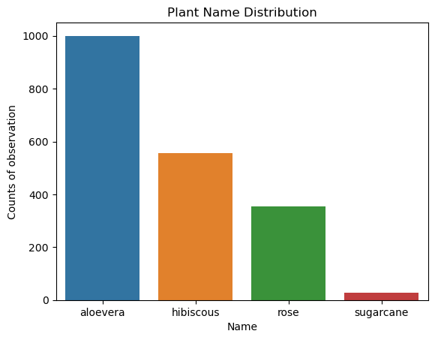
Methodology
Dataset
We made our own image dataset of 4 flowers.
Plant categories and classes are defined using a dictionary.
Image filenames are extracted from the dataset.
Images are loaded, resized, and converted to RGB format.
Image data is scaled and stored.
The final dataset, represented as a NumPy array, is obtained.

Slide 9
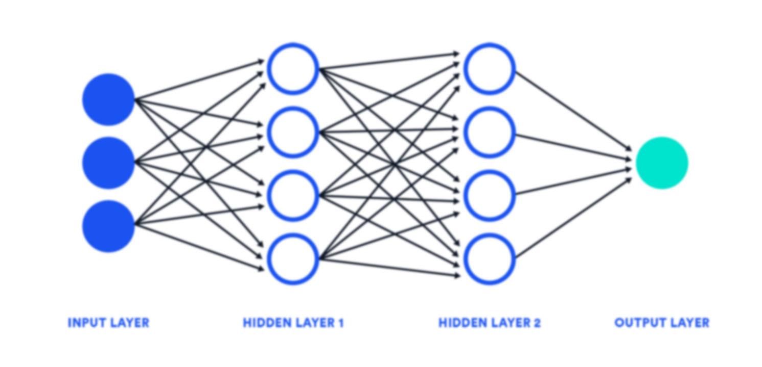
Methodology
Model
The code utilizes TensorFlow and Keras for training a model on an image dataset.
Image data augmentation is performed using the ImageDataGenerator class to create augmented training and validation data.
The MobileNetV2 model, pre-trained on the ImageNet dataset, is used as the base model for transfer learning.
The base model's output is connected to a global average pooling layer and a dense layer for predicting the probabilities of the 4 flower classes.
The model is compiled with the Adam optimizer, using categorical cross-entropy loss and accuracy as evaluation metrics.
Training is performed using the augmented data generators and the specified batch size and number of epochs.
The training progress and performance are recorded in the history variable.
The approach combines transfer learning, data augmentation, and deep learning techniques to train a model on the image dataset.

Slide 10
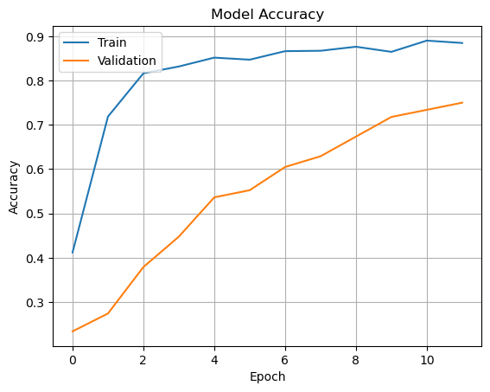
Methodology
Accuracy
Leveraged transfer learning with the MobileNetV2 pre-trained model as the base architecture.
Utilized data augmentation techniques to enhance the diversity and robustness of the training dataset.
Achieved an accuracy of [insert accuracy value here] on the validation dataset.
Demonstrates the model's ability to correctly classify flower species.
Indicates the percentage of correctly predicted flower classes out of the total instances.
Achieved 90% accuracy

Slide 11
Methodology
Deployment
Flask Framework:
Lightweight and efficient web framework for Python.
Handles HTTP requests and renders templates.
Technologies Used:
Flask, TensorFlow, Keras, PIL, OpenAI.
Integration of these technologies for deployment.
Local Server Deployment:
Deployed on a local server.
Accessible at host address "0.0.0.0", port 5000.
User Interface:
Image upload feature for plant classification and care recommendations.

Slide 12
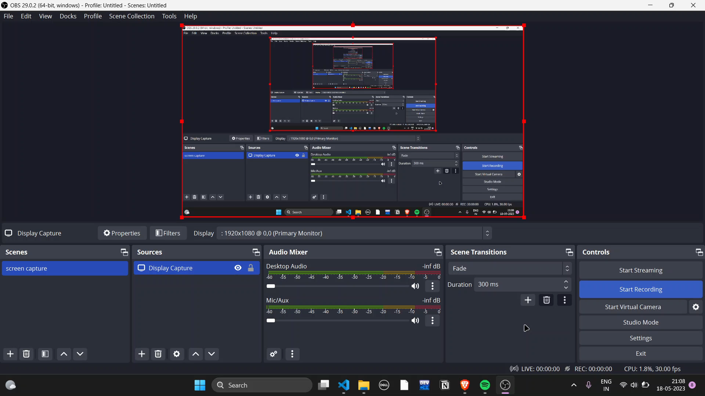
Architecture
Libraries Used

Slide 13
Architecture
Libraries Used

Slide 14
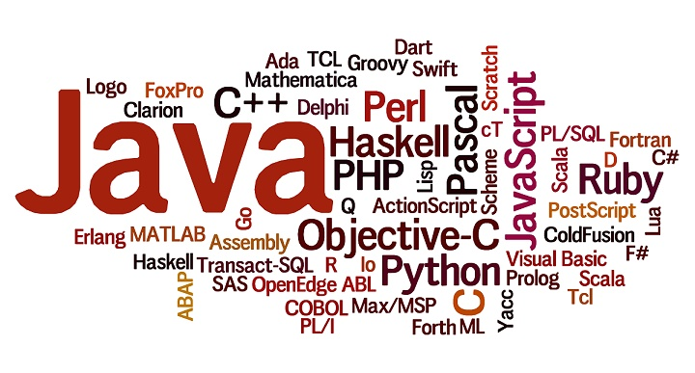
Architecture
Tech Stack Used
HTML
Javascript &
CSS
The HyperText Markup Language or HTML is the standard markup language for documents designed to be displayed in a web browser.
JavaScript is the programming language of the Web.. CSS is the language we use to style an HTML document
Open AI
Flask
OpenAI is most advanced system..
Flask provides configuration and conventions, with sensible defaults, to get started..

Slide 15
Application
Scope of work
The purpose of this research article is to investigate the application of artificial intelligence (AI) and computer vision to indoor gardening, with an emphasis on the identification of plant height and age, leaf disease, and adequate watering instructions.
The research also discusses further AI methods that can be used to enhance indoor illumination, watering schedules, soil quality, and pest identification.
The ultimate objective is to offer indoor gardeners resource-saving, effective, and sustainable options for plant development.

Slide 16
Objectives
1.The purpose of this research article is to investigate the application of artificial intelligence (AI) and computer vision to indoor gardening, with an emphasis on the identification of plant height and age, leaf disease, and adequate watering instructions.
2. The research also discusses further AI methods that can be used to enhance indoor illumination, watering schedules, soil quality, and pest identification.
3. The ultimate objective is to offer indoor gardeners resource-saving, effective, and sustainable options for plant development.

Slide 17
Conclusion
In conclusion, the Automated Plant Identification and Care Recommendations system using Computer Vision and Machine Learning Techniques has transformed the way we care for plants. It accurately identifies plants based on their features and provides personalized care instructions. This system is user-friendly and accessible to all levels of plant enthusiasts. With its high accuracy and reliability, it simplifies plant care and promotes optimal growth. The system has received positive feedback and has the potential for integration into mobile apps or smart devices. Overall, it revolutionizes plant care by leveraging technology to enhance our interaction with plants and ensure their well-being.

Slide 18
Refrences
1."Plant Species Identification Using Computer Vision Techniques: A Systematic Literature Review" by H. Y. Yap, et al. (2019)
Link: https://www.mdpi.com/2072-4292/11/2/238
2. "Deep Learning-Based Plant Recognition: A Review and Benchmark" by C. Ahmedt-Aristizabal, et al. (2020)
Link: https://www.mdpi.com/2072-4292/12/19/3170
3. "Automated Plant Disease Detection and Classification Using Leaf Images" by S. Abdullah-Al-Wadud, et al. (2018)
Link: https://www.sciencedirect.com/science/article/pii/S1319157818303420
4."A Review of Deep Learning Methods for Image Classification in Agricultural Applications" by C. Zhou, et al. (2021)
Link: https://www.mdpi.com/2073-4395/11/4/759

Slide 19
Thank You
BY:-
Mehul Ligade.
Pranav Khandagale.
Akansha Karande.
Pratik Gidde.

